Slide 1
Decision Tree

Slide 2
Typical Data Science Cycle
Data Collection
Business Insights & Understanding
Data Understanding
Model Building & Evaluation
Data Pre-Processing

Slide 3
Machine Learning
Supervised ML
(Target Variables)
Classification
Regression
Linear Regression (Causal) , Time Series
Decision Tree
Logistic Regression , Decision Tree

Slide 4
Ideation
Categorical Target Variable
Binary Variable (Two categories / Two Classes / Two Labels)
e.g. Yes/No, Churn/No-Churn, Spam/Non-Spam
Whether he will attend class tomorrow or not?
Whether he will pass exam or not?
Multi-class Variable (More than two categories / Classes / Labels)
e.g.
Size of an object in an image (small / medium / large)
Type of species in IRIS data set (virginica / setosa / versicolor)
Grouping related articles / books together (Google News)
Type of banking customer (low-affluent/ medium affluent / high net worth / super affluent)

Slide 5
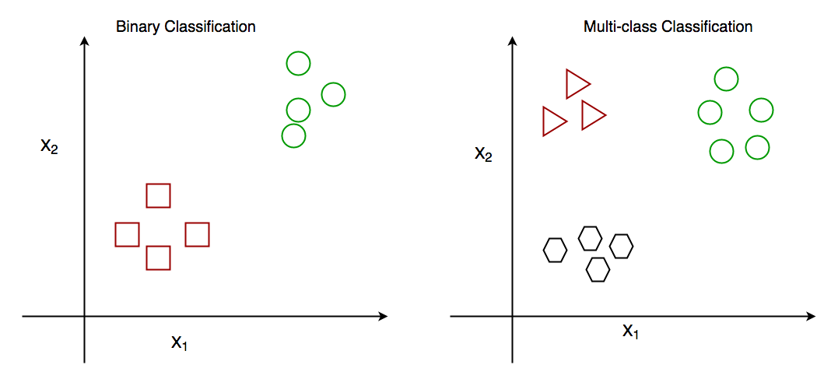
Ideation
What is the effective way to classify data into each category for both cases?
X2 = 3
X1 = 6

Slide 6

Ideation
What is the effective way to classify data into each category for both cases?
One Linear Classifier is enough
$$\log\left(\frac{P}{1−P}\right)=a+bx$$
X2 = 3
Multiple partitions required
X1 = 6

Slide 7
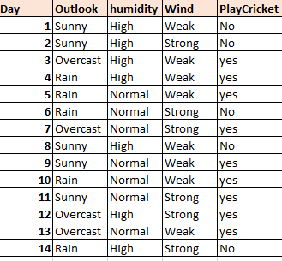
Ideation
Hard to visualize through charts so let’s create some rules to classify

Slide 8
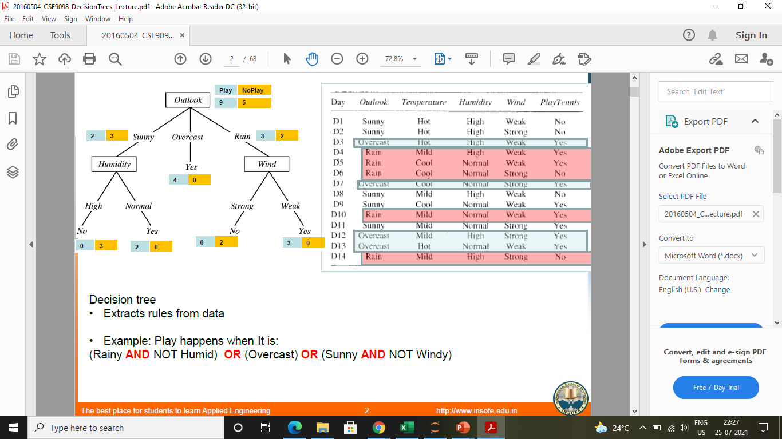
Ideation

Slide 9
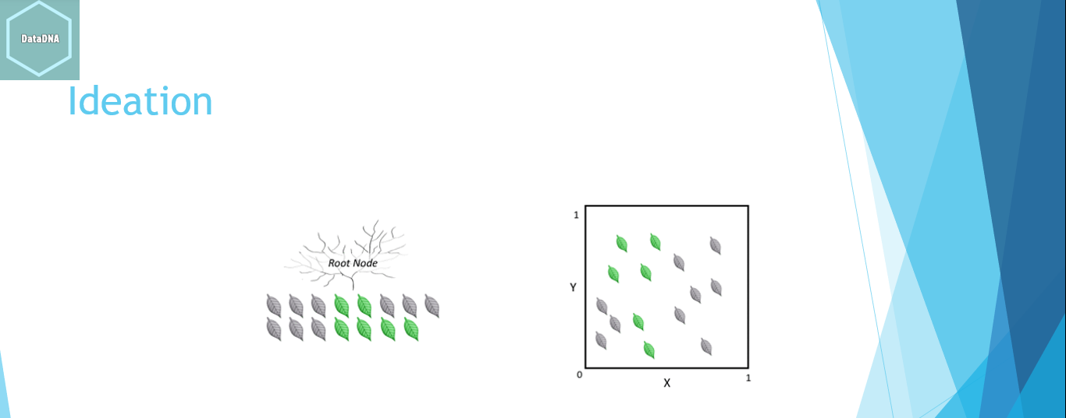
Ideation
Y = 0.5
X = 0.5

Slide 10
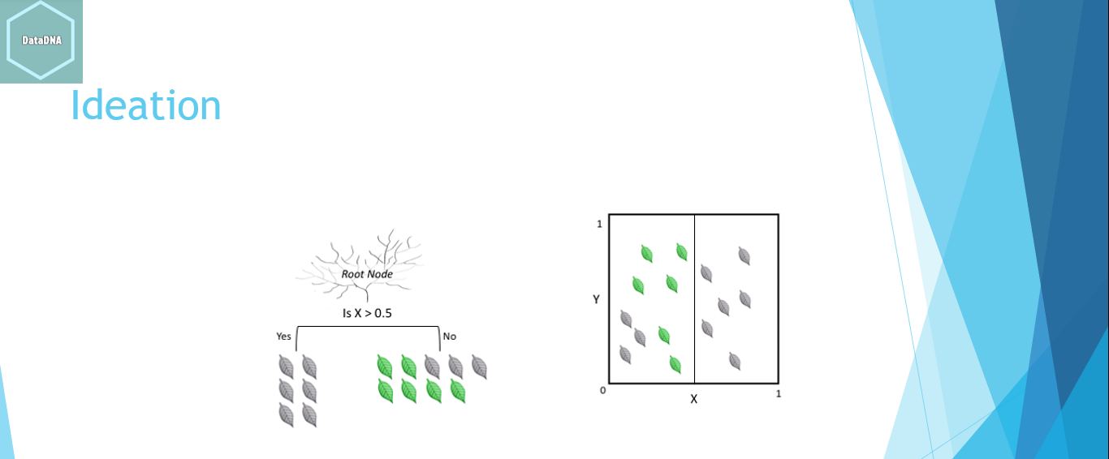
Ideation
Y = 0.5
X = 0.5

Slide 11
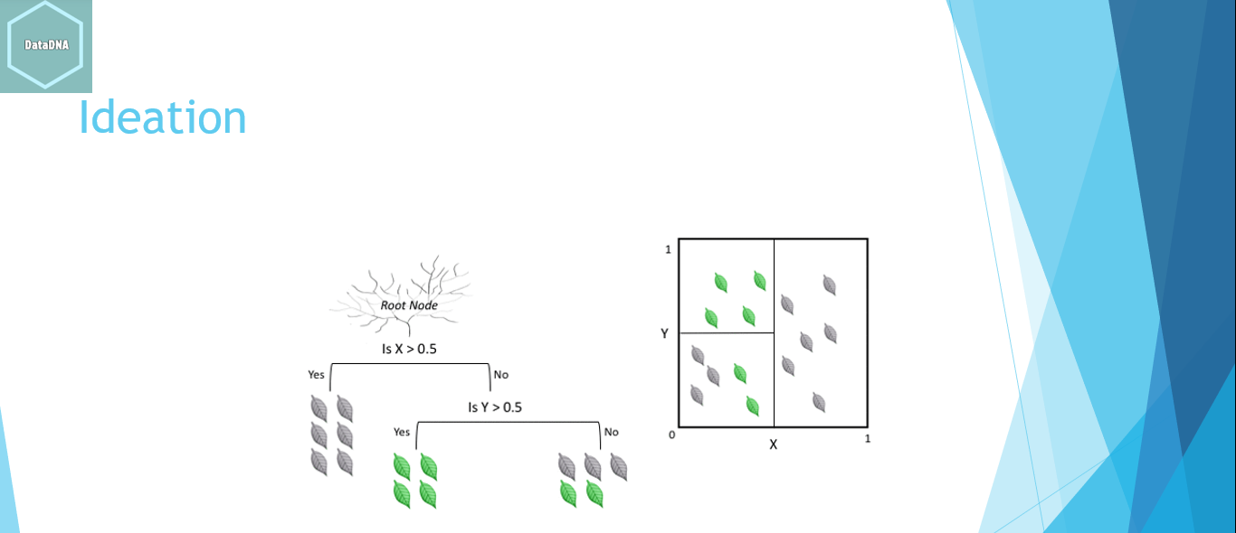
Ideation
Y = 0.5
X = 0.5

Slide 12
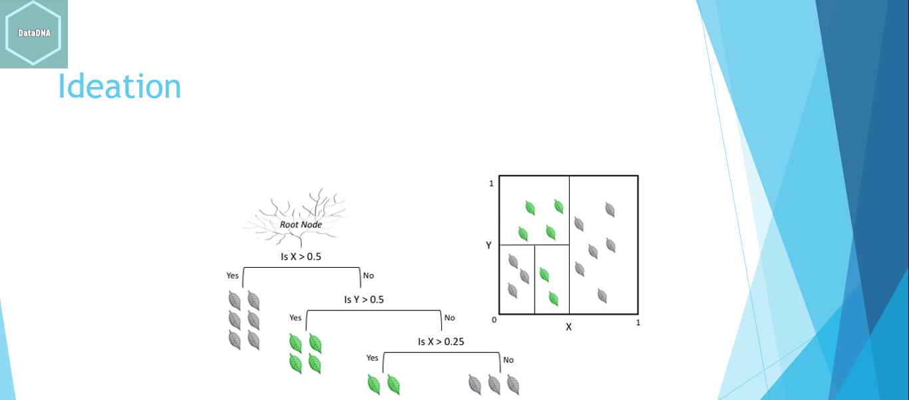
Ideation
X = 0.25
X = 0.5

Slide 13
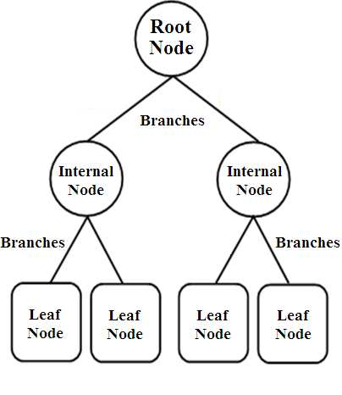
Introduction
A Decision tree is a flowchart like tree structure, which contains nodes and branches.
Internal node denotes a test on an attribute.
First internal node is called root node. Remaining internal nodes
are called decision node. These nodes performs splitting tests.
Each branch represents an outcome of the test
If any node is not further partitioned then it is called leaf node (terminal node). Each leaf node denotes the final results of a particular rule i.e. (label/class distribution)

Slide 14
Introduction
Tree based learning algorithms are considered to be one of the best and mostly used supervised learning methods.
Tree based methods empower predictive models with high accuracy, stability and ease of interpretation.
Unlike linear models, they map non-linear relationships quite well.
They are adaptable at solving any kind of problem at hand (classification or regression).
Methods like decision trees, random forest, gradient boosting are being popularly used in all kinds of data science problems.

Slide 15
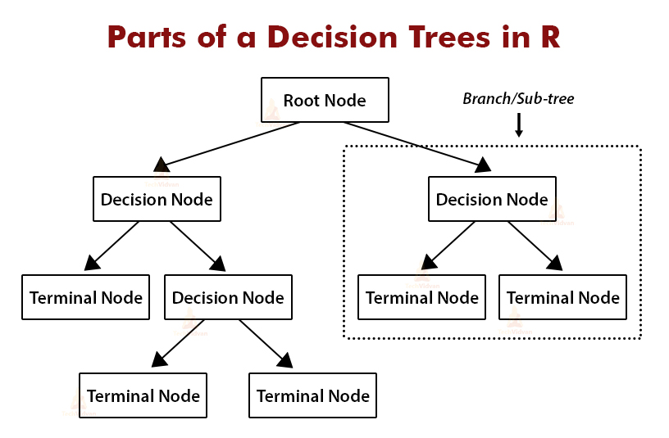
Common terms used with Decision trees:
Root Node: It represents entire population or sample and this further gets
divided into two or more homogeneous sets.
Splitting: It is a process of dividing a node into two or more sub-nodes.
Decision Node: When a sub-node splits into further sub-nodes, then it is called
decision node.
Leaf/ Terminal Node: Nodes do not split is called Leaf or Terminal node.
Branch / Sub-Tree: A sub section of entire tree is called branch or sub-tree.
Parent and Child Node: A node, which is divided into sub-nodes is called parent
node of sub-nodes whereas sub-nodes are the child of parent node.
Pruning: When we remove sub-nodes of a decision node, this process is called pruning.
You can say opposite process of splitting.

Slide 16
Construction of decision tree
Decision tree works on the principle of recursive partitioning where Recursive partitioning strives to correctly classify members of the population by splitting it into sub-populations based on more than one independent variables. The process is termed recursive because each sub-population may in turn be split an indefinite number of times until the splitting process terminates after a particular stopping criterion is reached.
Process :-
Place the best attribute (most informative) of the dataset at the root of the tree. Order to placing attributes at root node of the tree is done by using some statistical approach.
Split the Data set into subsets. Subsets should be made in such a way that each subset contains homogeneous values for target variable.
Repeat step 1 and step 2 on each subsequent decision node until you find leaf nodes in all the branches of the tree.
Process terminates after some predefined criteria achieved its threshold

Slide 17
Construction of decision tree
Identify target variable
Decision Tree works both for classification problem as well as regression problem.
Decision Tree Classifier : Target variable is categorical
e.g.
What is the outcome of cricket match (win /lose)
Whether car will breakdown (yes / no)
Decision Tree Regressor : Target variable is numerical
e.g.
Total income of customer
Total revenue from a single customer
Total likes on a facebook post given information about fb user, post characteristics

Slide 18
Construction of decision tree
Place the best attribute at root node /internal node
We do not choose random independent variable from dataset to perform splitting
Why Did we choose variable
“Outlook” at root node

Slide 19
Construction of decision tree
Place the best attribute at root node /internal node
Objectives :
To achieve homogeneous data set after splitting
We select attributes which are most informative

Slide 20
Construction of decision tree
Place the best attribute at root node /internal node
Methods to select best attribute for splitting when target variable is categorical :
Information gain
2. Gini Impurity (Gini index based method)

Slide 21

Construction of decision tree
Place the best attribute at root node /internal node
Information gain
Entropy is used for calculating the purity of a node.
Lower the value of entropy, higher is the purity of the node.
The entropy of a homogeneous node is zero. Since we subtract entropy from 1, the Information Gain is higher for the purer nodes with a maximum value of 1

Slide 22
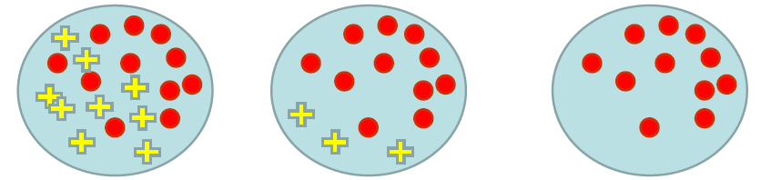
Construction of decision tree
Place the best attribute at root node /internal node
Entropy: A measure of homogeneity

Slide 23
Construction of decision tree
Place the best attribute at root node /internal node
Steps to decide best attribute using Information gain
For each split, individually calculate the entropy of
each child node
2. Calculate the entropy of each split as the weighted
average entropy of child nodes
3. Select the split with the lowest entropy or highest
information gain
Information gain = ( Entropy of system before split – Entropy of system after split )
4. Until you achieve homogeneous nodes, repeat steps 1-3

Slide 24
Construction of decision tree
Place the best attribute at root node /internal node
Information gain in Case ‘Outlook’
Information gain in Case ‘humidity’
Entropy = 0.9402
Yes = 9 No = 5
Entropy = 0.9402
Yes = 9 No = 5
Outlook
humidity
SPLIT USING ‘HUMIDITY’ IS BETTER
Sunny
Overcast
High
Normal
Rain
Yes = 2 No = 3
Yes = 3 No = 2
Yes = 4 No = 0
Yes = 3 No = 4
Yes = 6 No = 1
Entropy = 0.97
Entropy = 0.97
Entropy = 0
Entropy = 0.98
Entropy = 0.59
Entropy of Total Split = (0.97*5+0.97*5+0*5)/14 = 0.69
Entropy of Total Split = (0.98*7+0.59*7)/14 = 0.5607
Information gain = 0.9402 – 0.69 = 0.2473
Information gain = 0.9402 – 0.56 = 0.379

Slide 25


Construction of decision tree
Place the best attribute at root node /internal node
Gini Impurity
Gini index do not need logarithm hence it is simpler to calculate w.r.t. information gain
Gini Impurity is used for calculating the purity of a node.
Lower the Gini Impurity, higher is the homogeneity of the node.
The Gini Impurity of a pure node is zero.

Slide 26
Construction of decision tree
Place the best attribute at root node /internal node
Steps to decide best attribute using gini impurity
Similar to what we did in information gain. For each split, individually calculate
the Gini Impurity of each child node
2. Calculate the Gini Impurity of each split as the weighted average Gini Impurity
of child nodes
3. Select the split with the lowest value of Gini Impurity
4. Until you achieve homogeneous nodes, repeat steps 1-3

Slide 27
Construction of decision tree
Place the best attribute at root node /internal node
Gini impurity in Case ‘Outlook’
Gini Impurity in Case ‘humidity’
Yes = 9 No = 5
Yes = 9 No = 5
Outlook
humidity
SPLIT USING ‘HUMIDITY’ IS BETTER
Sunny
Overcast
High
Normal
Rain
Yes = 2 No = 3
Yes = 3 No = 2
Yes = 4 No = 0
Yes = 3 No = 4
Yes = 6 No = 1
gini impurity= 0.48
gini impurity = 0.48
gini impurity = 0
gini impurity= 0.489
gini impurity = 0.244
Gini Impurity of Total Split = (0.48*5+0.48*5+0*5)/14 = 0.34
Gini Impurity of Total Split = (0.489*5+0.244*5)/14 = 0.261

Slide 28
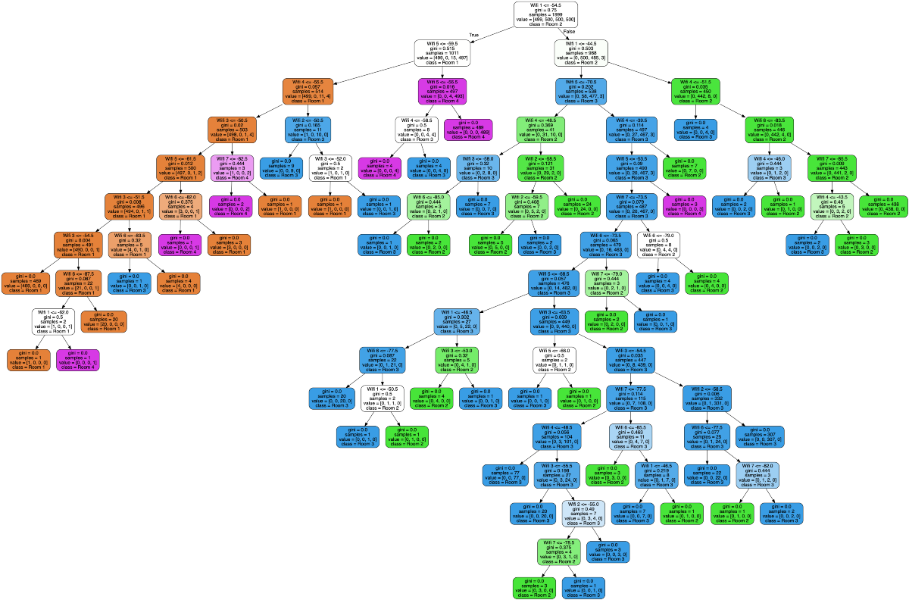
Construction of decision tree
Process Termination
For a large data set , If we keep continue splitting to reach perfect homogeneous leaf node, then tree might get complex
Disadvantages of complex Tree
Chances of overfitting (Good performance on training data
but poor performance on test/unseen data)
Very difficult to read and understand
Very computational heavy

Slide 29
Construction of decision tree
Process Termination
To avoid complexity , we need to terminate splitting process before all of the leaf nodes reaches to perfect homogeneous.
Following criteria can be used to stop tree to reach the end :
We can decide the maximum depth of the tree
We can decide minimum number of samples in a leaf node
We can decide minimum number of samples in an internal
node for splitting
4. We can decide maximum leaf nodes
5. We can decide minimum impurity decrease cutoff for a split.

Slide 30
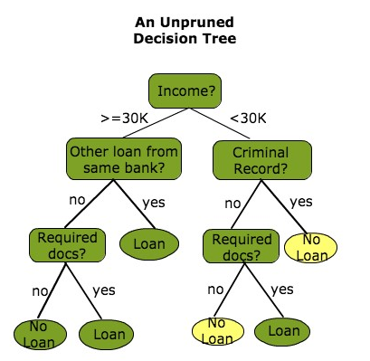
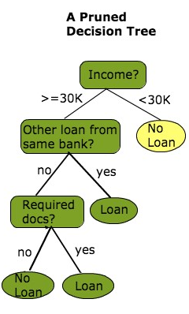
Construction of decision tree
Pruning
Stopping tree at early stage might cause overfitting and weak model.
To avoid complexity , We can also Allow the tree to overfit the data,
and then post-prune the tree layer by layer
(cutting branches )

Slide 31
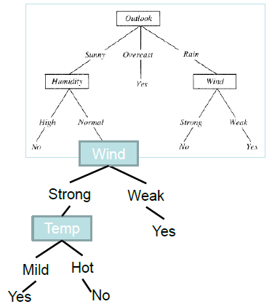
Construction of decision tree
Pruning
We can decide level of pruning (complexity of tree) by validating performance
on validation data.
There are various methods of pruning available :
Bottom-Top Approach:
Minimal Cost-Complexity Pruning
Reduced Error Pruning
Minimum Error Pruning
Top-Bottom Approach:
1. pessimistic error pruning

Slide 32

Construction of decision tree
In case of continuous target variable
Method of choosing variable for splitting : Reduction in Variance
Reduction in Variance is a method for splitting the node used when the target variable is continuous, i.e., regression problems.
If a node is entirely homogeneous, then the variance is zero.
Here are the steps to split a decision tree using reduction in variance:
For each split, individually calculate the variance of each child node
Calculate the variance of each split as the weighted average variance of child nodes
Select the split with the lowest variance
Perform steps 1-3 until completely homogeneous nodes are achieved

Slide 33
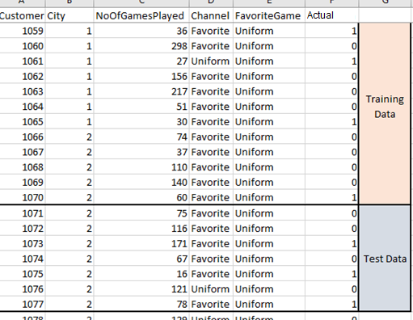
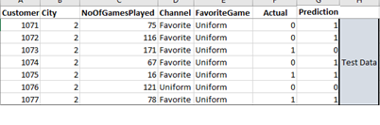
Performance Validation
Performance validation of Decision Tree
Modelling on Training Data
ML Model
Apply on Test Data
Prediction

Slide 34
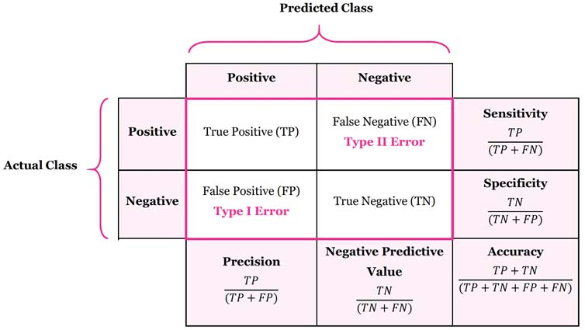
Model Evaluation Metrics
The various metrics used to evaluate the results of the prediction are :
Accuracy
Precision
Recall
Area Under ROC Curve
MAPE/ MAD/ RMSE (For Regressors)

Slide 35
Hyper parameter Tuning
criterion{“gini”, “entropy”}, default=”gini”
The function to measure the quality of a split. Supported criteria are “gini” for the Gini impurity and “entropy” for the information gain.
splitter{“best”, “random”}, default=”best”
The strategy used to choose the split at each node. Supported strategies are “best” to choose the best split and “random” to choose the best random split.
max_depth int, default=None
The maximum depth of the tree. If None, then nodes are expanded until all leaves are pure or until all leaves contain less than min_samples_split samples.
min_samples_split int or float, default=2
The minimum number of samples required to split an internal node:

Slide 36
Hyper Parameter Tuning
max_features int, float or {“auto”, “sqrt”, “log2”}, default=None
The number of features to consider when looking for the best split:
max_leaf_nodes int, default=None
Grow a tree with max_leaf_nodes in best-first fashion. Best nodes are defined as relative reduction in impurity. If None then unlimited number of leaf nodes.
min_impurity_decrease float, default=0.0
A node will be split if this split induces a decrease of the impurity greater than or equal to this value.
min_samples_leaf int or float, default=1
The minimum number of samples required to be at a leaf node. A split point at any depth will only be considered if it leaves at least min_samples_leaf training samples in each of the left and right branches. This may have the effect of smoothing the model, especially in regression

Slide 37
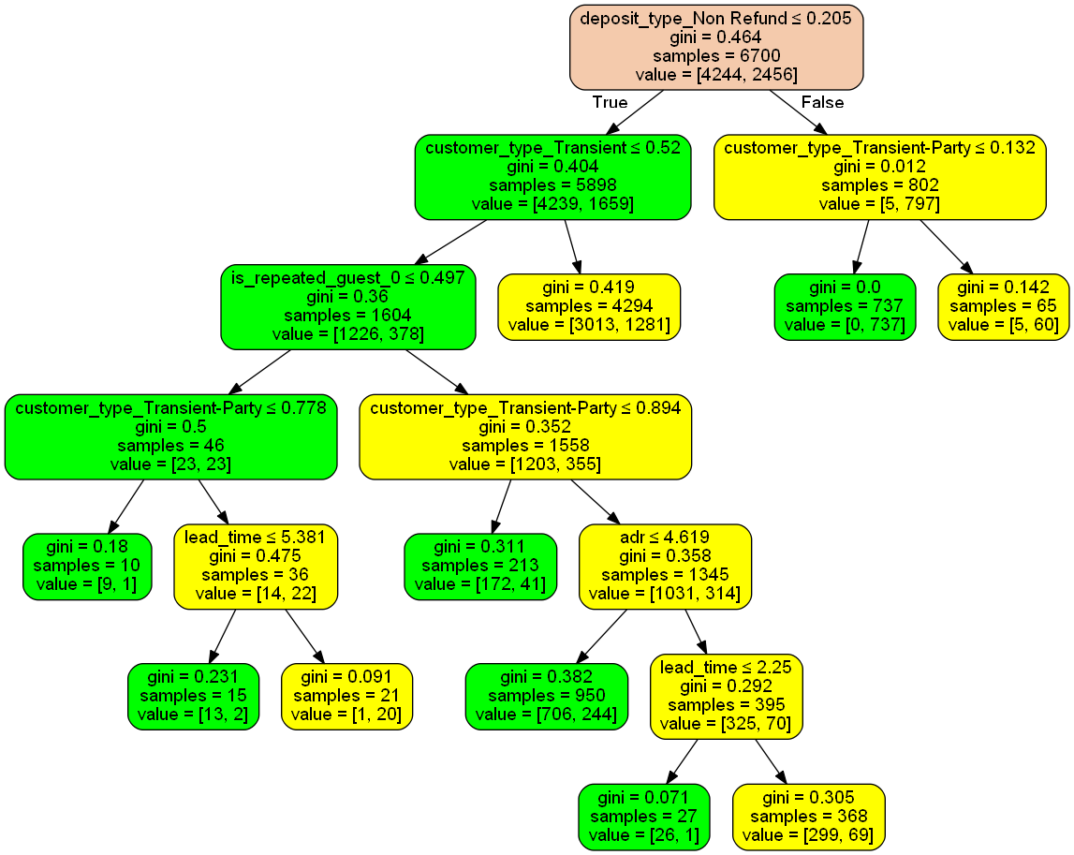
Model Inference

